Slide 1
Firewall
Presenter: MN. Sihanas
Lecturer: Mr. Mohamed Nismy

Slide 2
What is Firewall?
A firewall is a network security device that monitors and controls incoming and outgoing network traffic based on predetermined security rules.
Notes:
Firewalls act as a barrier between trusted and untrusted networks (e.g., internal networks and the internet) to prevent unauthorized access.

Slide 3
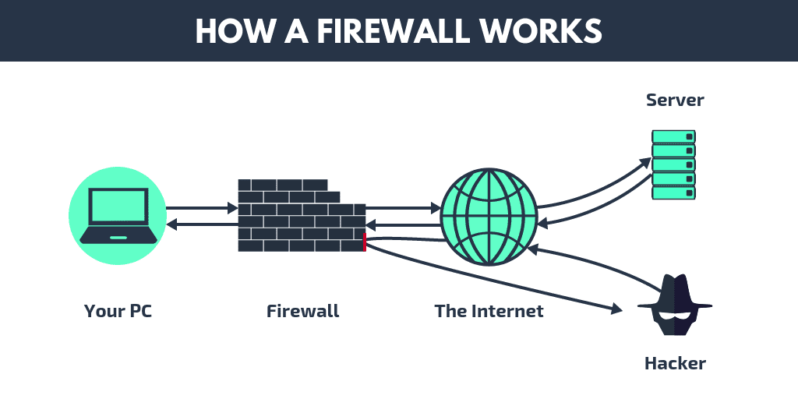
How it works?

Slide 4
Types of Firewall
Packet-Filtering Firewall
Stateful Inspection Firewall
Proxy Firewall
Next-Generation Firewall (NGFW)
Unified Threat Management (UTM)
Notes:
Packet-Filtering Firewall: Examines packets individually and allows or blocks them based on source/destination IP addresses, protocols, and port numbers.
Stateful Inspection Firewall: Tracks the state of active connections and makes decisions based on the state and context of the traffic.
Proxy Firewall: Intercepts traffic between sender and receiver, acting as an intermediary.
Next-Generation Firewall (NGFW): Offers deeper inspection by integrating additional features like intrusion prevention and encrypted traffic analysis.
Unified Threat Management (UTM): Combines firewall functions with other security services like antivirus, content filtering, and data loss prevention.

Slide 5
Advantages of Firewall
Network Security
Traffic Monitoring
Prevention of Malicious Activity
Customizable Rules
Notes:
Network Security: Protects against external threats by blocking unauthorized access.
Traffic Monitoring: Provides the ability to log and audit network traffic.
Prevention of Malicious Activity: Can block viruses, malware, and harmful applications.
Customizable Rules: Security policies can be tailored based on organizational needs.

Slide 6
Disadvantages of Firewall
Performance Issues
Complex Configuration
Limited Protection
Costs
Notes:
Performance Issues: Can slow down network traffic if not configured or managed properly.
Complex Configuration: Requires expertise to set up properly; misconfiguration can leave vulnerabilities.
Limited Protection: Firewalls alone cannot protect against internal threats or sophisticated attacks like phishing or social engineering.
Costs: High-end firewalls and maintenance can be expensive for organizations.

Slide 7
How to use Firewall
Log Monitoring
Update Regularly
Network Segmentation
Firewall Configuration
Notes:
Firewall Configuration: Define security rules, such as which traffic to allow or block based on IP, port, or protocol.
Network Segmentation: Separate internal networks into different segments to limit access.
Update Regularly: Ensure the firewall software is updated to include the latest security patches and threat intelligence.
Log Monitoring: Regularly monitor firewall logs to detect suspicious activity.

Slide 8
What Happens if a Firewall is Configured Wrongly?
Open Ports and Exposure
Unintended Blocking
Increased Vulnerability
Risk of Data Breach
Notes:
Open Ports and Exposure: Misconfiguration could leave ports open, allowing unauthorized access.
Unintended Blocking: Essential services or legitimate traffic could be blocked, disrupting business operations.
Increased Vulnerability: Weak or incorrect rules might leave the network susceptible to attacks.
Risk of Data Breach: Sensitive data could be exposed if firewall rules fail to block malicious traffic.

Slide 9

Conclusion
In the realm of network security, firewalls are indispensable tools that act as a frontline defence against cyber threats.
By implementing appropriate firewall technologies, organizations can effectively protect their networks from unauthorized access, malicious attacks, and data breaches.
Notes:
In the realm of network security, firewalls are indispensable tools that act as a frontline defence against cyber threats. By implementing appropriate firewall technologies, organizations can effectively protect their networks from unauthorized access, malicious attacks, and data breaches.

Slide 10

Thanks!
Any questions?

